Slide 1
Title: Network intrusion detection system using deep learning techniques.
Team no. 18:
Guide- R.Dharma Reddy
Mentor- Sai sri vasthav
Team members:
1602-18-737-108 Sushmitha
1602-18-737-114 Uday
1602-18-737-118 Vinuthna
1602-18-737-312 Kusuma

Slide 2
Abstract
Technology is rapidly evolving in a world driven by networks, online transactions and IoT devices. But with technological evolution comes the progress of cyber crime which continually develop new attack types and some remain untraceable.
Both ML and DL are powerful tools in learning useful features from the network traffic and predicting the normal and abnormal activities based on the learned patterns.
This process is done using real-time traffic monitoring to find out if any unusual behavior is present in the network or not..

Slide 3
Use cases
The developed Neural Network
Classification of the network flow as normal or attack.
Live Data must be obtained using Wireshark packet sniffing tool(open-source) and fed into the model.

Slide 4
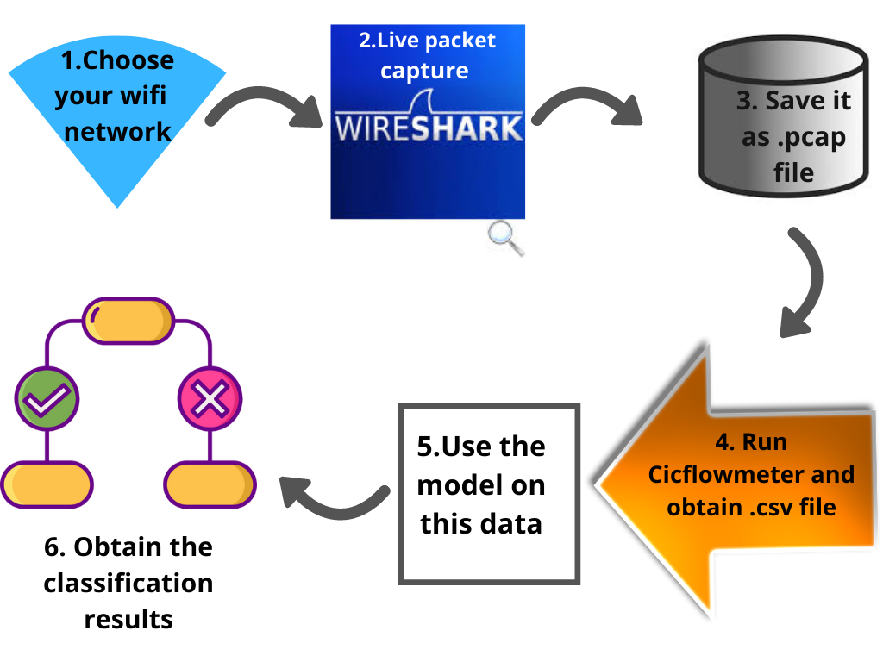
Flow of the project

Slide 5
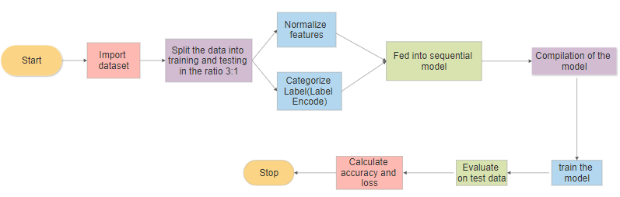
Flow chart of the model

Slide 6
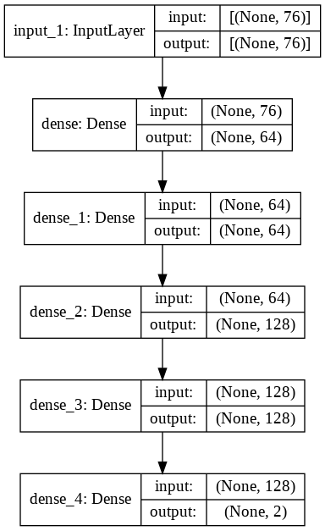
Architecture of the NN

Slide 7
Technologies used
Google Colab
Python 3.9
Tensorflow 2.5.0
Open source tools-
Wireshark
Cicflowmeter 4.0

Slide 8
Demo of the project

Slide 9
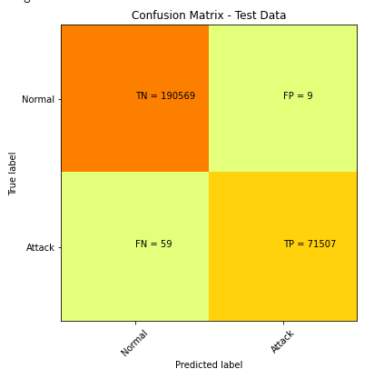
Performance metrics
Roc_Auc score
99.95%

Slide 10
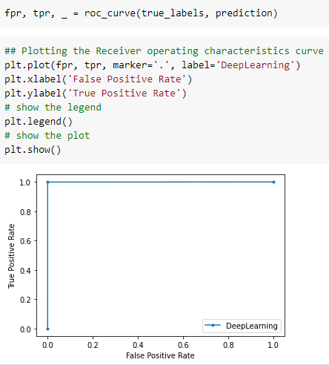
Cont..
Receiver Operating Characteristics Curve(ROC) :

Slide 11
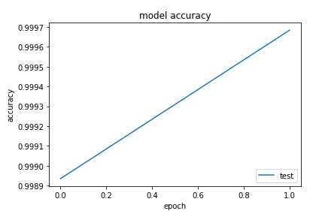

Cont...

Slide 12
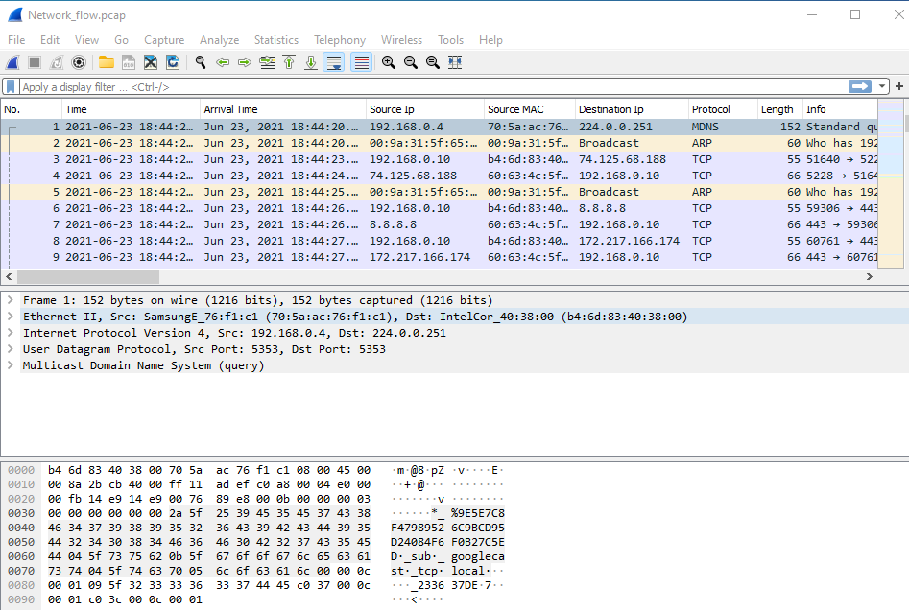
Results

Slide 13
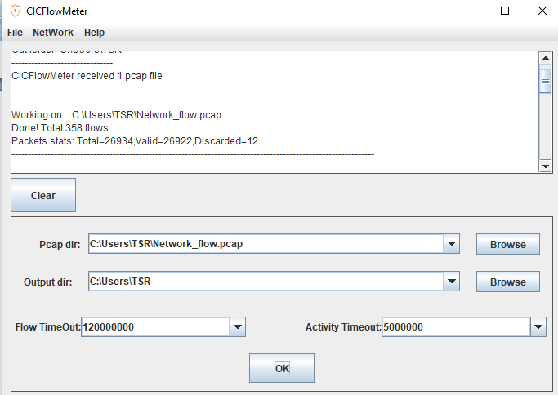
Cont.

Slide 14
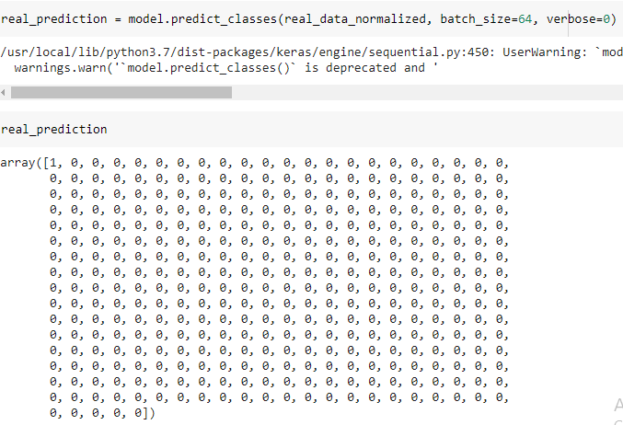
Output

Slide 15
Future Work
Evaluation of more machine learning algorithms to detect minority attacks efficiently with acceptable false positive rate and low cost of misclassification in future
Alert system using IoT
Automate the process
Deploying in organizations involving many devices connected to same network

Slide 16
Thank You ☺

